Slide 1



UNIVERSITY INSTITUTE OF ENGINEERING
COMPUTER SCIENCE ENGINEERING
Bachelor of Engineering
Design and Analysis of Algorithms(CST-302/ITT-302)
Prepared By: Amrita Chaudhary (E8745)
Topic: Recurrence Relation
DISCOVER . LEARN . EMPOWER

Slide 2
Learning Objectives & Outcomes
Objective:
To understand Recurrence relation and its various types.
Outcome:
Student will understand Recurrence relation and its various types and how to solve problems using these methods.

Slide 3
Recurrence Relation
A recurrence relation for the sequence, a0, a1, ...an, is an equation that relates an to certain of its predecessors a0, a1, ... , an-1.
Initial conditions for the sequence a0, a1, ... are explicitly given values for a finite number of the terms of the sequence.

Slide 4
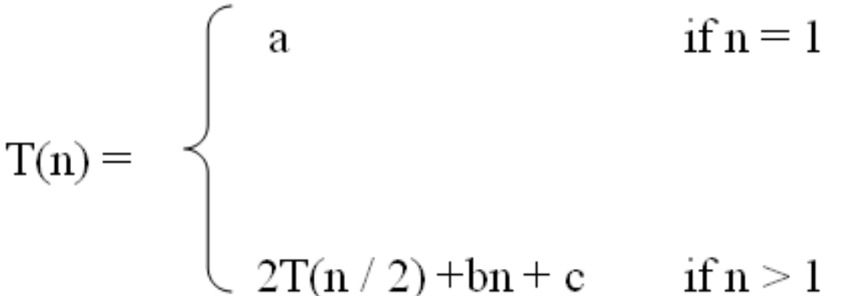
Definition
A recurrence relation, T(n), is a recursive function of integer variable n.
Like all recursive functions, it has both recursive case and base case.
Example:

Slide 5
Definition (Contd…)
The portion of the definition that does not contain T is called the base case of the recurrence relation; the portion that contains T is called the recurrent or recursive case.
Recurrence relations are useful for expressing the running times (i.e., the number of basic operations executed) of recursive algorithms

Slide 6
Solving Recurrence Relation
To solve a recurrence relation T(n) we need to derive a form of T(n) that is not a recurrence relation. Such a form is called a “closed form” of the recurrence relation.
There are four methods to solve recurrence relations that represent the running time of recursive methods:
  Iteration method (unrolling and summing)
  Recursion Tree method
  Substitution method
  Master method

Slide 7
Iteration method
Steps:
  Expand the recurrence
  Express the expansion as a summation by plugging the recurrence back into itself until you see a pattern.
  Evaluate the summation

Slide 8
Recursive Tree Methods
A recursion tree models the costs (time) of a recursive execution of an algorithm.
The recursion tree method is good for generating guesses for the substitution method.
The recursion-tree method can be unreliable.
The recursion-tree method promotes intuition, however.
In this case, only the largest term in the geometric series matters; all of the other terms are swallowed up by the Θ(·) notation.

Slide 9
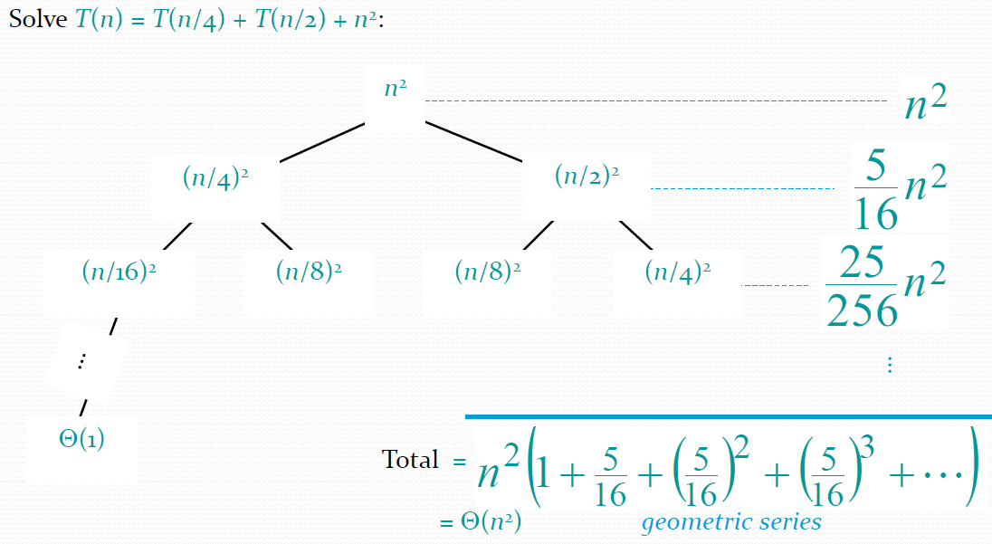
Example of recursion tree

Slide 10
Substitution Method
The substitution method
  A.k.a. the “making a good guess method”
  Guess the form of the answer, then use induction to find the constants and show that solution works
  Run an example: merge sort
    T(n) = 2T(n/2) + cn
    We guess that the answer is O(n lg n)
    Prove it by induction
  Can similarly show T(n) = Ω(n lg n), thus Θ(n lg n)

Slide 11
Example of Substitution Method
Example: T(n) = 2T(n/2) + n
Guess T(n) ≤ cn log n for some constant c (that is, T(n)= O(n log n))
T(n) = 2T(n/2) + n ≤ 2(c n/2 log n/2 ) + n
= cn log n/2 + n
= cn log n − cn log 2 + n
= cn log n − cn + n
if c ≥ 1 , condition is satisfied.
Thus, T(n) = O(n log n)

Slide 12
The Master Theorem
Given: a divide and conquer algorithm
  An algorithm that divides the problem of size n into a subproblems, each of size n/b
  Let the cost of each stage (i.e., the work to divide the problem + combine solved subproblems) be described by the function f(n).
Then, the Master Theorem gives us a method for the algorithm’s running time:

Slide 13
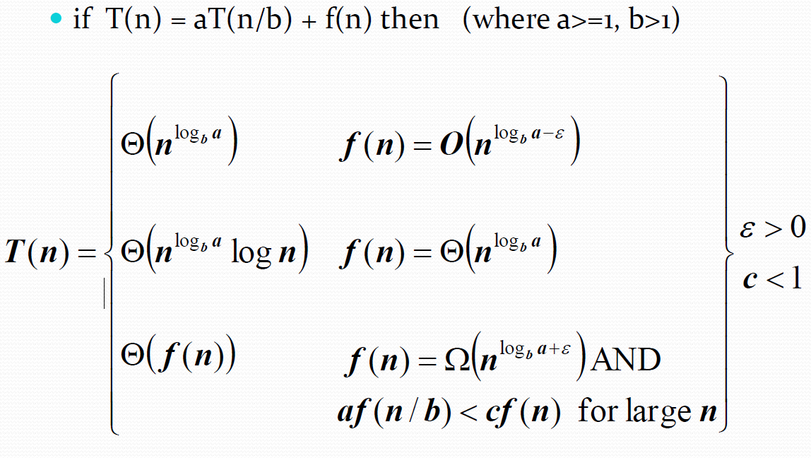
The Master Theorem (Contd..)

Slide 14
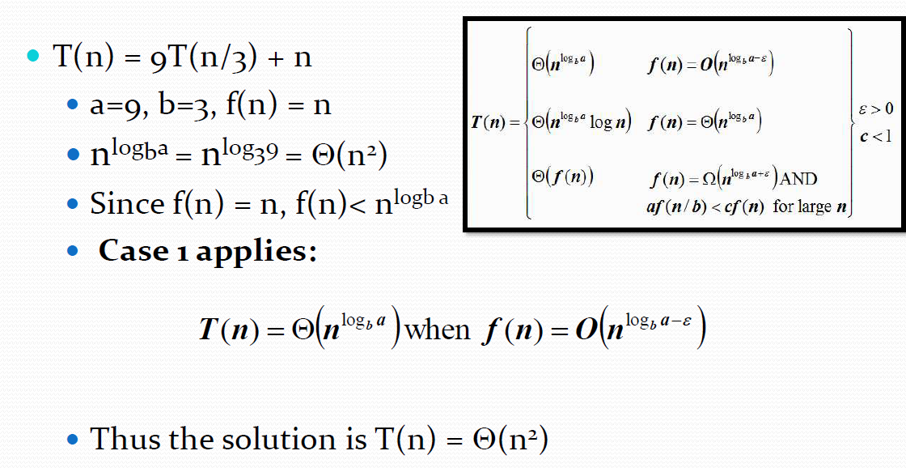
Using the Master Theorem

Slide 15
REFERENCES
Text books:
Cormen, Leiserson, Rivest, Stein, “Introduction to Algorithms”, Prentice Hall of India, 3rd edition 2012. problem, Graph coloring.
Horowitz, Sahni and Rajasekaran, “Fundamentals of ComputerAlgorithms”, University Press (India), 2nd edition
Websites:
https://www.javatpoint.com/daa-recurrence-relation#:~:text=Recurrence%20Relation,its%20values%20on%20smaller%20inputs.&text=For%20Example%2C%20the%20Worst%20Case,is%20described%20by%20the%20recurrence.

Slide 16
Summary
Recurrence Relation
  Iteration method (unrolling and summing)
  Recursion Tree method
  Substitution method
  Master method

Slide 17
THANK YOU

